Slide 1
PINT PoC Scenarios

Slide 2
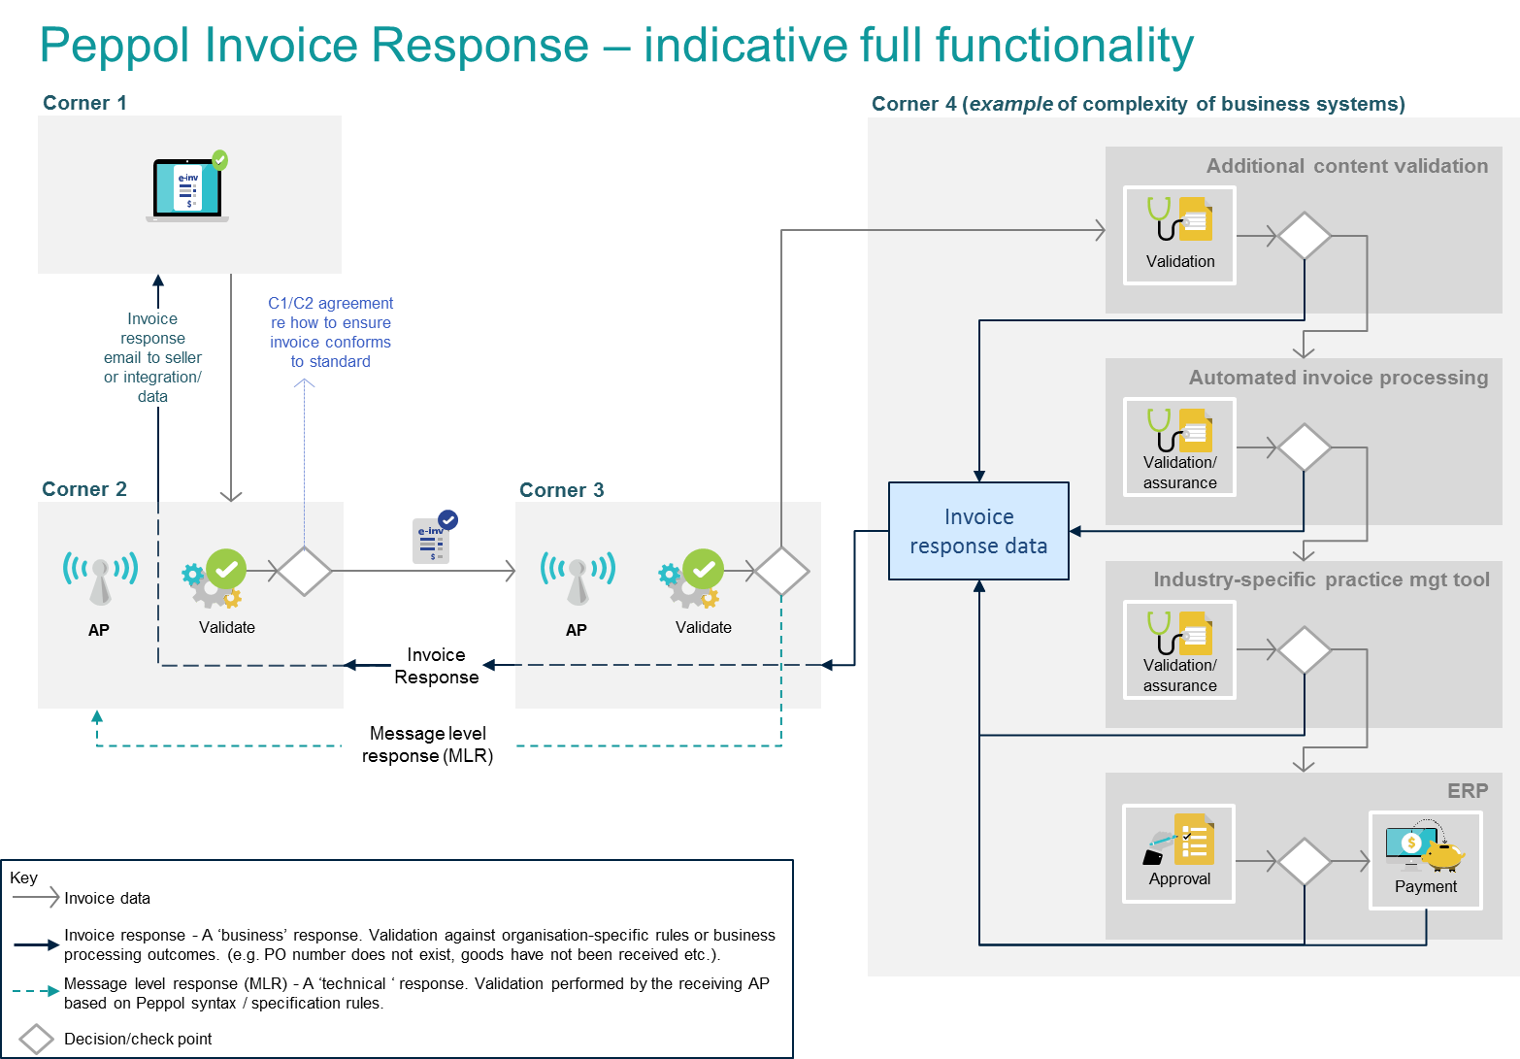
Enterprise scenario

Slide 3
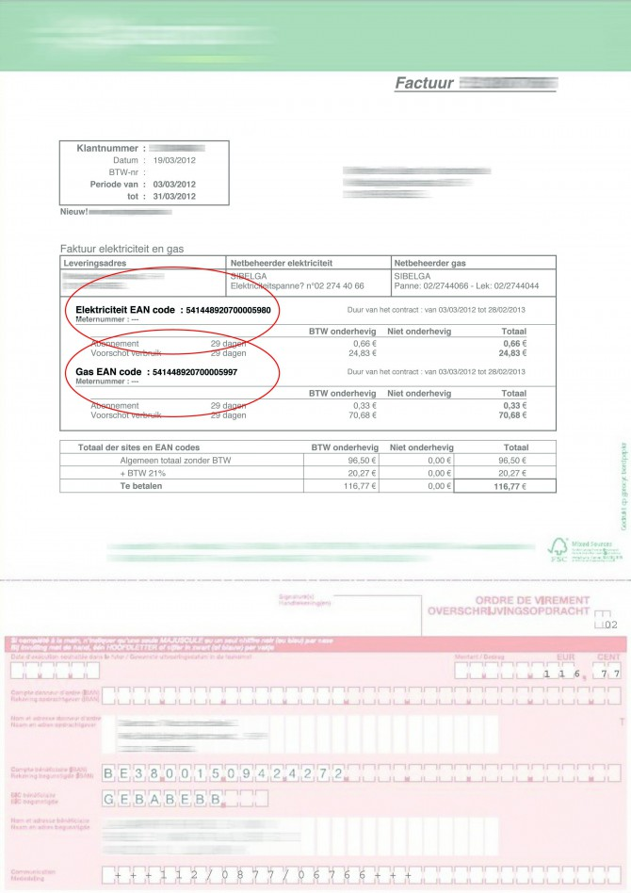

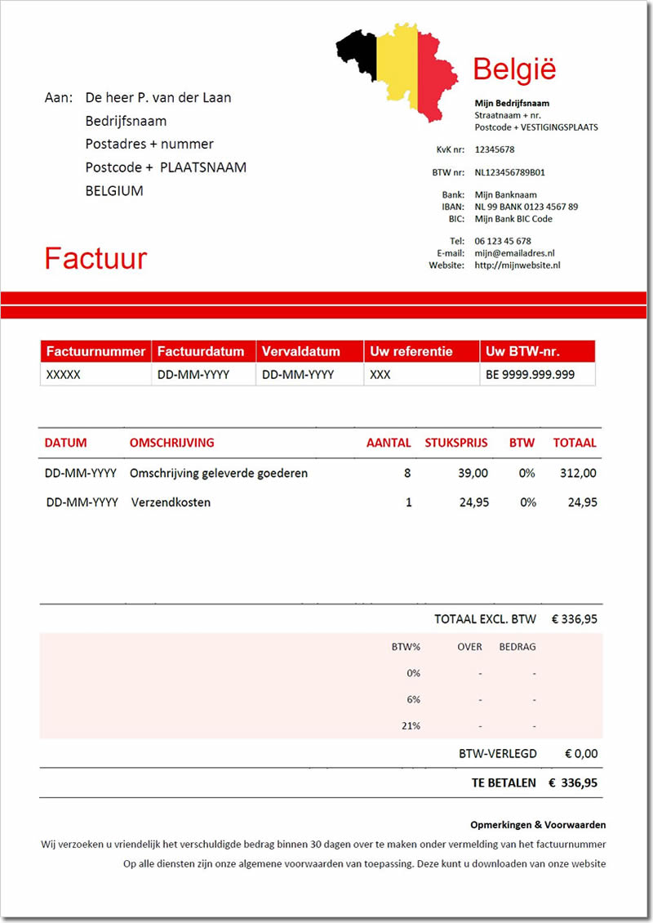




SME with External accountant scenario
E-Mail / Print
E-Mail / Print
Connection
Peppol
Connection
Peppol
Access point
Access point
ERP software
Portal software
François (Plumber)
Brigitte (Administrator)
Sales journal
Purchase journal
Julie (Accountant)
Pierre (Accountant)
Accounting software
Accounting software

Slide 4
General flow – Same jurisdiction
C1
EU Sender
C4
EU Receiver
C2
C3

Slide 5
General flow – Same jurisdiction
Sending capabilities
PINT/EN16931/BIS3
PINT/EN16931/BIS3/BE
Receiving capabilities
PINT*
PINT/EN16931/BIS3*
PINT/EN16931/BIS3/BE
Suggested sending combinations for testscenario
PINT/EN16931/BIS3
PINT/EN16931/BIS3/BE
Invoice
Creditnote
With EU TAX
Out of scope of EU TAX
Received as
PINT/EN16931/BIS3
PINT/EN16931/BIS3/BE

Slide 6
General flow – Different jurisdiction
C1
EU Sender
C4
SG Receiver
C2
C3

Slide 7
General flow – Different jurisdiction with mandatory PINT* registration
Sending capabilities
PINT/EN16931/BIS3
PINT/EN16931/BIS3/BE
Receiving capabilities
PINT*
PINT/SG/BIS3*
PINT/SG/BIS3/F1
Suggested sending combinations for testscenario
PINT/EN16931/BIS3
PINT/EN16931/BIS3/BE
Invoice
Creditnote
With EU TAX
Out of scope of EU TAX
Received as
PINT/*

Slide 8
General flow – Different jurisdiction without PINT* registration
Sending capabilities
PINT/EN16931/BIS3
PINT/EN16931/BIS3/BE
Receiving capabilities
PINT/SG/BIS3*
PINT/SG/BIS3/F1
Suggested sending combinations for testscenario
- Not possible to send invoices to different jurisdiction
Received as
- Not possible to receive invoices from other jurisdiction

Slide 9
Possible combinations in general
Jurisdictions
AUNZ – AUNZ
AUNZ – EU
AUNZ – JP
AUNZ – SG
EU – EU
EU – AUNZ
EU – JP
EU – SG
JP – JP
JP – AUNZ
JP – EU
JP – SG
SG – SG
SG – AUNZ
SG – EU
SG – JP
Documents
Positive invoice
Negative invoice
Positive creditnote
Negative creditnote
With local tax
Without local tax

Slide 10
Scenarios C1 – C2
C1 sends native SP file to C2
C1 no change
C2 checks the DDTS receiving capabilities
C2 creates a valid PINT invoice and corresponding SBDH
Possible contract change to support PINT
C1 sends native SP file to C2
C1 no change
C1 mandates the use of a specific PINT specification due to business agreement with C4
C2 checks the specific PINT specification against the DDTS receiving capabilities
C2 creates a valid PINT invoice and corresponding SBDH
Possible contract change to support PINT

Slide 11
Scenarios C1 – C2
C1 sends a PINT compliant invoice to C2
C1 has to upgrade its software from BIS3 to PINT
C2 checks the DDTS receiving capabilities
C2 creates a corresponding SBDH
Possible contract change to support PINT
C1 sends a BIS3 compliant invoice to C2
C1 no change
C2 checks the DDTS receiving capabilities
C2 creates a valid PINT invoice and corresponding SBDH
Possible contract change to support PINT

Slide 12
Scenarios C3 – C4
C3 sends a native SP file to C4
C3 has to upgrade its systems to receive PINT invoices with possible change to the native file
or C3 renders a PDF for invoices from other jurisdictions
C4 has to upgrade its software to be able to process the new native file
or C4 uses the PDF for invoices coming from other jurisdictions
Possible contract change to support PINT
C3 sends the PINT invoice to C4
C3 has to upgrade its systems to receive PINT invoices
C4 has to upgrade its software to be able to process a PINT invoice
Possible contract change to support PINT

